Slide 1
MPI Sessions v2
Initial Ideas

Slide 2
Issues to be covered by MPI Sessions v2
Support for Malleability
  Grow and shrink resources (announced / in cooperation)
Support for Fault Tolerance
  Shrink resources (announced)
  Grow resources to replace
Coupling between two jobs
  Worst case of two systems
Reasoning/Control of “connected” resources –> MPI Bubbles
  Convex group of sessions with own resource isolation
Integration of Sessions into MPI_T
  Monitor within areas of isolation / respect isolation also in tools
How to deal with non-versioned objects, like datatypes

Slide 3
MPI Sessions v2
Use Cases

Slide 4
Collection of Use Cases (Summary)
Individual applications with changing resource (requirements)
Coupled application(s) (components)
(Partly) Co-located independent applications
System software to schedule independent applications

Slide 5
Collection of Use Cases (1)
Individual applications with changing resource(s) (requirements)
  Cooperative: application negotiates with runtime system and follows changes
  Selfish: application one-sided grabs resources (and releases, but less likely)
    What happens if resources are not there? Chance of deadlocks?
  Coercive: scheduler/runtime can take resources away at any time
    With warning asking application to react: what happens if not?
    Without warning: (almost) same case as fault tolerance
    Could be combined

Slide 6
Scenario: Growing (Cooperative/Coercive)
Role of the runtime/res.man. to find consensus group?
Old Bubble
New Bubble
Bubble
Process 1
Process 1
Process 1
Session
App 1
Session
App 1
Session
App 1‘
Session
App 1‘
Negotiate new
Resources
(Coervice: recognice
new ressources)
Need to update
Process set
New name
New version
Consencus problem
Migrate data
(if needed)
Finalize old
Sessions with
all processes
present
Process 2
Process 2
Process 2
Session
App 2
Session
App 1
Session
App 2‘
Session
App 2‘
Process 3
Process 3
Process 3
Session
App 3
Session
App 1
Session
App 3‘
Session
App 3‘
Process 4
Process 4
Bubble
Session
App 4‘
Session
App 4‘
Options: 1) query all sets
2) Give me the latest one
(race condition could be an issue,
fail at comm creation?)
Create new MPI process
(user must initialize session and needs to know of late start)
(needs to know which process set to use)

Slide 7
Example of Honest Resource Negotiation
Role of the runtime/res.man. to find consensus group?
New Scalability Information
becomes available
Bubble
Old Bubble
New Bubble
Process 1
Process 1
Get information about new set → name?
Process 1
Session
App 1
Session
App 1
Session
App 1‘
NEED
SYNC
1
App provides either
hard request
or indicator
Migrate data
(if needed)
Finalize old
Sessions with
all processes
present
Process 2
Process 2
Process 2
Session
App 2
Reaction:
Callback
or Polling
(or both)
MPI
Request
Based?
Perhaps even
Persistent op?
Need to be able
to cancel it?
Session
App 2
Session
App 2‘
2
Process 3
Process 3
Process 3
Session
App 3
RM decides
Session
App 3
Session
App 1‘
Session
App 3‘
Process 4
Process 4
Bubble
System State
Session
App 4‘
Session
App 2‘
Create new MPI process
(user must initialize session and needs to know of late start)
(needs to know which process set to use)
Two use cases:
Sync/Iteration based (collective)
Async tasking (local)

Slide 8
API Issues Send in Request
1
API for direct/hard constraints
  Input: Resource vector (GPU, CPU, memory, ) → MPI processes with traits
    How much of that belongs into the MPI interface?
    Or just provide a mechanism to communicate that (XML, BLOB, Info, …)
  App know what it wants
API for indirect/soft constraints

Slide 9
API Issues Send in Request / via different API
1
Does MPI have to have a role in specifying resources?
  Hard to standardize, different resources
Alternative:
  SLURM call to request resources
    Can be granted fully/partly/not → not MPI
  MPI side: notification or a pull for new resources
    That gives us an option to integrate it
How does this work to re-implement SLURM on MPI?

Slide 10
API Issues Notification
2

Slide 11
Call 1: Ask for resources
Application asks for resources
Option 1a: SLURM/RM call (not MPI) that specifies type of resource
  Potentially creates processes, e.g., in the form Session process sets
Option 1b: Generic MPI call that specifies MPI processes
  Info keys, which standardized somewhere else –> string format
Option 2: MPI call that takes a BLOB/XML/String to be interpreted by the RM
Option 3: MPI specifies resources

Slide 12
Call 2: notified that MPI processes are present
Option 1: Repeatedly/Frequently query for new Session process sets
  Once a new name or new version appears, we can create a new group and then a new communicator
  MISSING: existing call (possibly versioning – NONE if version pattern)
  MISSING: convenience function → esp. in a “persistent” version
    When a process set appears (could be much quicker, but thread problems)
    When a particular process set appears (by name) (can’t be much)
    When a new version appears (also this won’t much better: tree vs. list)
    NEEDS: state token to be thread safe to refer back to previous search
    COULD ask for sorted list from MPI --> tree/log search in app
  OPTION: changes in session? → threading issues → asking for latest set?
    Could be mitigated by having to use the new set version (monot. Incr. version number)
Option 2: Async. Notification that MPI processes are there
  Callback – triggers specified at callback set time
    When a process set appears
    When a particular process set appears (by name)
    When a new version appears
  MISSING: New MPI API call to register the callback
  This would be supported by PMIx already (events or callbacks)

Slide 13
Missing: Versioning
Issue 1: Naming
  What is the relationship between two sets with similar names, but different version
    Aren’t there completely different?
  Need to forget older sets
    Could be done by versioning
    Or needs call to forget older name
Issue 2: Querying
Issue 3: Consistency in communicator creation
  Fail if not consistent
  Processes can try
    Option 1: all will fail -> not implementable (BAD OPTION)
    Option 2: all can fail, but don’t have to (BAD OPTION)
    Option 3: only outdated fail (RIGHT)
      An error returned by this routine means that the version passed in is no longer valid
      Either newer version available or no valid version (of that process set name)
  Alternative (or additionally): pass name as now
    Get newest ”possible” set, MPI returns that
    App can then query the version, app can decide to keep it or redo it
  Problem: doesn’t work with groups, may need a set→comm call (convenience call)
    Or group caches the process set version it is created from
    CommFromGroup fails if the groups came from different versions
  Alternative: set name level: consistent level
  Important: this function (comm or setname level) needs to be non-local

Slide 14
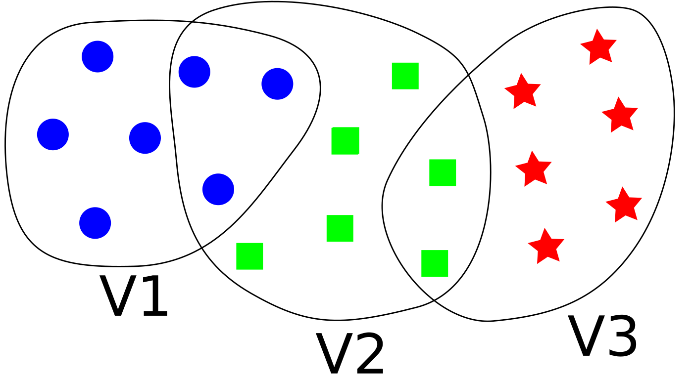
Discussion Point – “shifting” sets
ADD
WORDS

Slide 15
Fixed Bubbles Model
Role of the runtime/res.man. to find consensus group?
New Scalability Information
becomes available
Bubble
Old Bubble
New Bubble
Process 1
Process 1
Get information about new set → name?
Process 1
Session
App 1
Session
App 1
Session
App 1‘
NEED
SYNC
1
App provides either
hard request
or indicator
Migrate data
(if needed)
Finalize old
Sessions with
all processes
present
Process 2
Process 2
Process 2
Session
App 2
Reaction:
Callback
or Polling
(or both)
MPI
Request
Based?
Perhaps even
Persistent op?
Need to be able
to cancel it?
Session
App 2
Session
App 2‘
2
Process 3
Process 3
Process 3
Session
App 3
RM decides
Session
App 3
Session
App 1‘
Session
App 3‘
Process 4
Process 4
Bubble
System State
Session
App 4‘
Session
App 2‘
Session
App 1‘‘
Create new MPI process
(user must initialize session and needs to know of late start)
(needs to know which process set to use)
Two use cases:
Sync/Iteration based (collective)
Async tasking (local)
Session
App 2‘‘

Slide 16
Dynamic Bubbles Model
Role of the runtime/res.man. to find consensus group?
New Scalability Information
becomes available
Bubble
Old Bubble
New Bubble
Process 1
Process 1
Get information about new set → name?
Process 1
Session
App 1
Session
App 1
Session
App 1‘
NEED
SYNC
1
App provides either
hard request
or indicator
Migrate data
(if needed)
Finalize old
Sessions with
all processes
present
Process 2
Process 2
Process 2
Session
App 2
Reaction:
Callback
or Polling
(or both)
MPI
Request
Based?
Perhaps even
Persistent op?
Need to be able
to cancel it?
Session
App 2
Session
App 2‘
2
Process 3
Process 3
Comm
Process 3
Session
App 3
RM decides
Session
App 3
Session
App 3‘
Comm
Process 4
Process 4
Bubble
System State
Session
App 4‘
Session
App 2‘
Session
App 1‘‘
Create new MPI process
(user must initialize session and needs to know of late start)
(needs to know which process set to use)
Two use cases:
Sync/Iteration based (collective)
Async tasking (local)
Session
App 2‘‘

Slide 17
A Very Simple Sample Code
// outer loop iterations
for (size_t i = 0; i < rc->niters; i++) {
// Rebalance work
rebalance_work(rc, buf, &wr);
// Actual work
work(buf, wr.start, wr.end);
}

Slide 18
A Very Simple Sample Code + Boilerplate
MPI_Session_init
PS= Query Process Set (“World”)
G= Create group(PS)
Comm=Create_comm_from_group(G)
// outer loop iterations
for (size_t i = 0; i < rc->niters; i++) {
// Rebalance work
rebalance_work(rc, buf, &wr, Comm);
// Actual work
work(buf, wr.start, wr.end, Comm);
}

Slide 19
A Very Simple Sample Code + Boilerplate + Adapt
MPI_Session_init
PS= Query Process Set (“World”)
G= Create group(PS)
Comm=Create_comm_from_group(G)
// outer loop iterations
for (size_t i = 0; i < rc->niters; i++) {
// Rebalance work
rebalance_work(rc, buf, &wr, Comm);
// Actual work
work(buf, wr.start, wr.end, Comm);
}

Slide 20
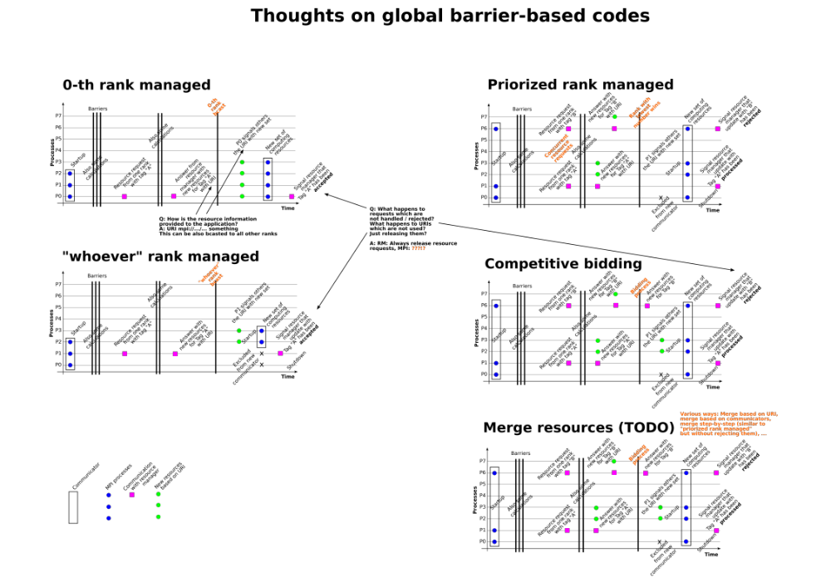
LINK
TO
PDF

Slide 21
PMIx has the same discussion
Name-Spaces in PMIx will have the same issues
Options:
  Fences/Epochs
  Exposed to user at the code level via explicit syncs
    Sync not part of PMI, user would do that
    Still need enough information in the group name

Slide 22
Consensus Finding for New Process Sets
Role of the runtime manager like PMIx
  Ability to query all process sets
Does this work for frequently changing resources?
First global operation could fail (comm create from group)
  Could throw an error if process sets are not consistent
  Would this work with multiple comms that need to be adjusted
    Non atomic operations
Could return set name from negotiation
  But this ties together new resources with a global construct
  Wanted to avoid this with sessions, as we may not want all resources
  Should be a two step process
When to reach consensus?
  Pro-active: During negotiations (which then needs to be multiphase)
    Seems to be the preference for now for growing / shrinking may be a different thing
  Re-active: At communicator/bubble creation (allows for one step negotations)
Discuss urgency, scalability for resource negotiations, measure of urgency, scalability useful to a scheduler’s optimizer. Who defines urgency – policy decision for system use? (8/3/20 discussions)

Slide 23
TBD: How to make the negotations?
Elastic MPI took the pro-active way plus „one way negotations“
  All resources accepted to run on, but consensus was trivial
What if an application doesn‘t want all
  This may/likely will turn into an iterative way
  Number and „type“ of resources
  How to do this with a consistent „voice“?
Does Coercive growing even make sense?
  Or should there always be an option to „refuse“ resources?
  Could leave extra resources hanging, but implications may be tricky
Could be triggered by either side, though
  I could use resources, do you have any?
  I have extra resources, could you use any?
  And which ones?
    Performance (locality) / Capability (memory/Accel.) / Security
    Complex area – need to provide flexibility (starting point probably just processes)

Slide 24
Scenario: Growing (Selfish) – fold into above?
Old Bubble
New Bubble
Bubble
Process 1
Process 1
Process 1
Session
App 1
Session
App 1
Session
App 1
Session
App 1
Request new
Resources
(must block
or fail/timeout –
but that‘s not the
MPI way)
Need to update
Process set
New name
New version
Migrate data
(if needed)
Finalize old
Sessions with
all processes
present
Process 2
Process 2
Process 2
Session
App 2
Session
App 1
Session
App 2
Session
App 2
Process 3
Process 3
Process 3
Session
App 3
Session
App 1
Session
App 3
Session
App 3
Process 4
Process 4
Bubble
Session
App 4
Session
App 4
With a more pro-active negotation
this could be folded in, as a reaction
to not getting what you want!
Create new MPI process
(user must initialize session and needs to know of late start)
(needs to know which process set to use)

Slide 25
Request (Selfish or Coop) to Grow
Request N as part of a negotation (Step 1: Optional)
  From anywhere or a particular process set (or targeted subset)
    Answer can depend permissions, priority, owner, availability
    Optional: Ask for locality as extra parameter
    Optional: Ask for best proximity as extra parameter
    Optional: Allow for oversubscription
  Answer:
    you can get 0, N, 0<i<N only being coercive
    you can get 0, N, 0<i<N without being coercive, but selfish
    you can get 0, N, 0<i<N without being selfish
Accept in the range or ask again (Step 2: Selfish, if coop, after neg.)
  Once accepted, you will get resources
  Accept call triggers the new process sets
  PROBLEM: races
  Accept is similar to a selfish grow
  OR same call with a „I Commit Flag“
Return: process set name (?) (Step 3)
  Possible the return in step 1 and the ask for that set in step 2
  Not a hard reservation, but keeps the information
To avoid races, need some negotiated reserv. token (alike MPROBE)
  Timeout? Is it really guaranteed or just information of what we want?
  Too much in the weeds?

Slide 26
Notification of having been grown (Coercive)
Use case: resources for a task-based/-like model
  Throw resources my way if you have them
  Start a general request ahead of time
  Get async notification when there
  (Does this make sense for the Coop/Selfish Case as well)
  Could be made very light-weight and dynamic
Task = Bubble
  Growing in the way above means tearing down and recreating a bubbles with more processes
  Here: growing = a new bubble -> communication with that bubble?
    Dependencies?
Synchronous / Polling
Asynchronous / Interrupt
MPI_T Events???

Slide 27
When Growing
Intent is to replace a bubble
  Negotiate more resources
    New process set version appears on all existing processes
    Growing can be done with full All2All
  Once granted, delete old bubble, create bubble as superset
Intent is to grow bubble
  One/some processes create new communicators using new process sets
    New process sets appear on some existing processes
    Growing has to be done through some intermediary processes
  Implicitly grows the bubble
Intent is to create a new bubble
  Ask for a new (external) bubble
RESTART
HERE

Slide 28
Growing Model
Step 1: Negotiate request
Step 2: Make request
  This is then always selfish
  No response directly
Step 3: Get notificaton that new resources are there
  Async via callback
  By blocking calls or completion of non-blocking
  Returns new resources (in the form of a process set)

Slide 29
Scenario: Shrinking (Cooperative)
Old Bubble
New Bubble
Bubble
Process 1
Process 1
Process 1
Session
App 1
Session
App 1
Session
App 1‘
Session
App 1‘
Negotiate new
Resources
See if you should
shrink or not
Need to update
Process set
New name
New version
Migrate data
(if needed)
Finalize old
Sessions with
all processes
present
Exit process 3
(assumes no other session on that
process, up to programmer to deal with that, would have to include this into the initial negotation setup)
Process 2
Process 2
Process 2
Session
App 2
Session
App 1
Session
App 2‘
Session
App 2‘
Process 3
Process 3
Session
App 3
Session
App 1
Bubble

Slide 30
Scenario: Shrinking (Selfish)
Note: may need to coercive way to reclaim resources if just paused
Old Bubble
New Bubble
Bubble
Process 1
Process 1
Process 1
Session
App 1
Session
App 1
Session
App 1
Session
App 1
Application
Decides
And
Initiates
The
Shrink
Migrate data
(if needed)
Finalize old
Sessions with
all processes
present
Exit/Pause process 3
(assumes no other session on that
process, up to programmer to deal with that, would have to include this into the initial negotation setup)
Process 2
Process 2
Process 2
Session
App 2
Session
App 1
Session
App 2
Session
App 2
Process 3
Process 3
Session
App 3
Session
App 1
„Negotiate“ to
give back
Resources
But RM will
never say no
What happens
to the process
Set (name/version)
Bubble
Does this fit the coopeartive threading scenario, where you „pause“ execution on a resource?
Could come back later in growing step („lending“)
Difference between return to RM or pause execution
Alternative to exit
„Donate yourself“
Especially in workflows

Slide 31
Pausing/Lending/Sharing Resources
What does this for the MPI resources
  Do communicators, etc. strick around?
Separate from shrinking bubble ideas
  Separable concepts
Lend whole remainder of bubbles?
  All but what is in the „remain active bubble“
  Allows setting up things
  When returned, bubble can stay active again
Fits to Howard‘s use case for Sessions v1 (in ECP)
  „QUO“ example

Slide 32
Scenario: Shrinking (Coercive) / FT
Could lead to inconsistenies in error handlers used (is this per Session?) – what do we do then?
Old Bubble
New Bubble
Bubble
Process 1
Process 1
Process 1
Session
App 1
Session
App 1
Session
App 1‘
Session
App 1‘
Process 3 fails
or gets retracted
All communicators,
windows, files, …
derived from groups
derived from sessions
with that process in
the initial process set
become defunct
→ Bubbles pops (does this mean the error
Handler on the Bubble gets called?)
Creates new version of process set
(naming scheme or set version)
Used to initialize new sessions
Restore data
(if needed)
and comm
in new bubble
Finalize old
Sessions
(how to do that
with only part
of the session
present?)
Process 2
Process 2
Process 2
Session
App 2
Session
App 2
Session
App 2‘
Session
App 2‘
Process 3
Process 3
Session
App 3
Session
App 3
Matches what we have now as a full WORLD env.
Would be FATAL by default (for WM), but can change
For SM may want a different default
Bubble
Scope of „invalidation“ when fault happens?
Soft Kill (kill) vs.
Hard Kill (kill -9)

Slide 33
Scenario: Replace (Coercive) / FT or Forced Migration
Old Bubble
New Bubble
Bubble
Process 1
Process 1
Process 1
Session
App 1
Session
App 1
Session
App 1‘
Session
App 1‘
Restore data
(if needed)
and comm
in new bubble
Finalize old
Sessions
(how to do that
with only part
of the session
present?)
Process 3 fails
or gets retracted
All communicators,
windows, files, …
derived from groups
derived from sessions
with that process in
the initial process set
become defunct
→ Bubbles pops
Creates new version of process set + runtime starts new process and adds it to the set
(naming scheme or set version)
Used to initialize new sessions / can be queried for its size
Process 2
Process 2
Process 2
Session
App 2
Session
App 2
Session
App 2‘
Session
App 2‘
Process 3
Process 3
Process 3
Process 3
Session
App 3
Session
App 3
Session
App 3‘
Session
App 3‘
Bubble
Need to Query if New/Diff. – via name agreement?
How to find the right version? Negotiation options?
What is the latest consistent version? Iterate until you have the right one?

Slide 34
Timeline

Slide 35
Options
Coercive = Pushed on you / no chance to react / just happens
Selfish = I decide and it is that way / or I decide to fail
Coop = Negotation / Willingness to compromise
 | Responder Negotiates | Responder Ignores | Responder Complies
Initiator Coop Grow
Initiator Selfish Grow Take resources High Permission level | N/A FAIL if out of resources
Initiator Coercive Grow | N/A | N/A | ALWAYS has complied Led to a coercive shrink
Initiator Coop Shrink
Initiator Selfish Shrink Resources just go away Basically a failure But warning, requires reaction | N/A
Initiator Coercive Shrink Resources just go away Basically a failure No warning | N/A
Set query / Set change detection ???
Initiates vs. Responding
Partners: RT to RT / App to RT / App to App
Is this the same? 9 Boxes? 6x6?
(App initiates vs. RT initiates vs intent to grow/shrink)

Slide 36
Goal: growing resources of an MPI job
Coercive -> take resources and cannot work without them
  Not getting them is a system failure
  UNIX signal Kill -9
  Only available to „special“ apps that are runtimes (-> root processes)
Selfish -> take resources and cannot work without them
  Not getting them forces me to wait or decide to give up
  UNIX signal Kill
Cooperative –> ask for them and potentially work without them
  Not getting them or less is OK
  UNIX signal SIGINT

Slide 37
Goal: growing resources of an MPI job
Needs to be a call at some point to start the process
  MPI_Grow(<resource descriptor>)
    Return process set (name and possible version)
      Anon. Resources (e.g., give me 10 processes)
    OR query possible process sets (that are incomplete)
      Known resources -> you are part of a set, but there are some left
    OR query process sets that I don‘t own at all, yet

Slide 38
Collection of Use Cases (2)
Coupled applications
  Independent components that need to be scheduled
  From tightly couple to loosely coupled workflows
  Part of one larger application, i.e., parts know of each other / need each other
Each component has its own (separate/non-overlapping) process set
  Creates sessions, groups, communicators from that
  Separate bubbles
Additionally, larger process sets must exist
  All processes known
  Union of component process sets
  Smaller cross component sets
Naming? Querying?

Slide 39
Scenario: Cooperative Components
Bubble 3 / Intercomponent
Process 1
Process 4
New bubble created either from
Separate process set
Form union set
(but this requires some form of
communication to find processes)
Session
C 1.1
Session
IC
Session
IC
Session
C 2.1
Process 2
Process 5
Session
C 1.2
Session
IC
Session
IC
Session
C 2.2
Process 3
Process 6
Session
C 1.3
Session
C 2.3
Bubble/Component 1 & 2 form independently
OR
Carve themselves off at the beginning
Same MPI, Same machine (???)
Bubble 1
Comp. 1
Bubble 2
Comp. 2

Slide 40
Collection of Use Cases (3)
(Partly) Co-located independent applications
  I/O, Tools, Vis, Data Analytics, Steering
  Possibly being able to dis/re-connect
Main application runs as usual
  One or more sessions by itself / could have components
  Not aware of the tool in itself
  But, tool needs to be boot-strapped into application (e.g., P/QMPI)
    Used to create separate communication sessions
Initial contact / connection / work / finalization
  Tool boostraps in application and creates sessions, then lies dormant
  User starts frontend and creates session
  Frontend triggers dormant tools
  Identify name of process set, create communicator
  Once complete, delete bubble
  If frontend drops, pop bubble

Slide 41
Scenario: Tool Frontend
Isolation concerns
Performance of bubble 2
Process 5 can‘t take down Sim in Bubble 2
Different Users??? – let other users connect
  Sharing of sim results
Other use cases: edge/sensing/data read-in
Bubble 1 = Comm
Bubble 2 = Comm
Session
Vis 1
Session
Comp 1
Process 1
Session
Vis 2
Session
Comp 2
Process 2
Session
Vis 5
Session
Vis 3
Session
Comp 3
Ext. Process
(e.g. I/O or
frontend node)
Process 3
Session
Vis 4
Session
Comp 4
Process 4
Slow Network, perhaps Tree
Fast Network

Slide 42
Scenario: Tool Frontend (with User)
Isolation concerns
Performance of bubble 2
Process 5 can‘t take down Sim in Bubble 2
Different Users??? – let other users connect
  Sharing of sim results
Other use cases: edge/sensing/data read-in
User Process, e.g., Laptop
Bubble 1 = Comm
Bubble 2 = Comm
Session
User FE
Session
Vis 1
Session
Comp 1
Process 1
Remote / Desktop
Session
Vis 2
Session
Comp 2
Process 2
Session
User FE
Session
Vis 5
Session
Vis 3
Session
Comp 3
Ext. Process
(e.g. I/O or
frontend node)
Process 3
Session
Vis 4
Session
Comp 4
Process 4
Slow Network, perhaps Tree
Fast Network

Slide 43
Collection of Use Cases (4)
System software to schedule independent applications
  MPI used as base communication for an entire cluster
  Includes job scheduling, i.e., 1 Bubble = 1 Job
  Jobs can have different sizes and “come and go”
  Each job has its own MPI://WORLD
Requirements
  Strong isolation
  Enforcement mechanisms
Evtl. remote query mechanisms
  Ask for other available bubbles/job
  Allow for “bridge” bubbles (IJC = Inter Job Communication)

Slide 44
Scenario: MPI used in Resourcemanager
„System Bubble“ = All Nodes managed (can also grow or shrink)
Job Bubble 1
Job Bubble 1
Job Bubble 1
MPI
Session
MPI
Session
MPI
Session
MPI
Session
MPI
Session
MPI
Session
MPI
Session
MPI
Session
MPI
Session
MPI
Session
MPI
Session
MPI
Session
MPI://WORLD
MPI
Session
MPI
Session
MPI
Session
MPI
Session
MPI
Session
MPI
Session
MPI
Session
MPI
Session
MPI
Session
MPI
Session
MPI://WORLD
MPI://WORLD
MPI://WORLD

Slide 45
Do we need Master Sessions?
„System Bubble“ = All Nodes managed (can also grow or shrink)
Job Bubble 1
Job Bubble 1
Job Bubble 1
MPI
Session
MPI
Session
MPI
Session
MPI
Session
MPI
Session
MPI
Session
MPI
Session
MPI
Session
MPI
Session
MPI
Session
MPI
Session
MPI
Session
MPI://WORLD
MPI
Session
MPI
Session
MPI
Session
MPI
Session
MPI
Session
MPI
Session
MPI
Session
MPI
Session
MPI
Session
MPI
Session
MPI://WORLD
MPI://WORLD
MPI://WORLD

Slide 46
Re-creating SLURM
SLURM Bubble
SLURM
Head
Session
FAIL
I/O via MPI
I/O via MPI
SLURM
Daemon
Session
SLURM
Daemon
Session
I/O via pipes
FORK
MPI
Session
MPI
Session
MPI
Session
MPI
Session
MPI
Session
MPI
Session
MPI
Session
MPI
Session

Slide 47
Other concerns
Redirect I/O???

Slide 48
MPI Sessions v2
Concept of MPI Bubbles

Slide 49
MPI Bubbles
Idea: create sets of Sessions across processes that “belong together”
  These bubbles are protected against each other
  They can be deleted/killed/removed without impacting others
Deletion/Destruction of a bubble can mean two things
  Remove MPI resources
  Remove MPI resources and processes
Can express some of this with the different error handlers we already have

Slide 50
Creation of MPI Bubbles
Option 1: Implicitly / No new functions, just based on Sessions
  Sessions gets created as usual
    Each session handle has one or more communicators (and derived objects) associated
    Each of these communicators is created from a session in each process
    The set of these sessions is again associated with a set of communicators
    …
    The fixpoint set of session handles forms the MPI bubbles
Consequences
  Bubbles can shrink or grow as communicators get created or freed
    Applications can use this similar to elastic-MPI (transition phase with old/new comm.)
    Similar to connected processes concept
  Bubbles can be split or grow without an application noticing
  All without affecting communicators
  BUT: only a virtual concept
  What does this do to isolation?
    Bubbles can merge if I start using process sets across bubbles
    Security problem: other resources outside could kill the bubble via “intermediary” (outside HPC)
    Do we need a “lock-down” operation that clamps the current size of a bubble down?
      If something adds to the bubble, it would fail
      Would avoid unintended failure propagation
    Could also be a performance problem (inside HPC – creation of performance domains)

Slide 51
Reasons for Locking of Bubbles
Security
  Avoid malicious impact from „external“ MPI processes via intermediary
  For non classical HPC use cases / Client/Server
Fault Isolation
  Protection of bubbles against each other
  Limit fault propagation
Performance
  Resources in my bubbles should not be affected by adding of resources
  Limit internal complications caused by unknowingly adding new “HW“
Impact of scope of seeing process sets
  Once protected that could be limited
  May then need an option to explicitly publish sets
Need also an unlock operation to open things up again
  Add symmetry

Slide 52
How would we lock an MPI Bubble

Slide 53
Problems with Implicit Bubbles
Issue: what if a bubble ends up with 2+ session handles per process?
  Possible if there is an overlap at another process
  Option 1: deal with it – makes revokes possibly harder
  Option 2: disallow by convention
  Option 3: allow limited use of process sets
  Option 4: explicit bubbles

Slide 54
Creation of Bubbles (cont.)
Option 2: Explicitly
  Processes create Sessions
  Query process sets
  Explicitly create a bubble from one group or set – one bubble per session
  Query WORLD and SELF in bubbles
Seems a bit klunky
  Kind of a double concept

Slide 55
What to do with MPI Bubbles
Delete entire bubbles
  MPI_Free_bubble (active destroy, collective operation)
  Explicitly release all resources associated with the bubble
New error handler
  MPI_ABORT_BUBBLE
  Trigger an abort of entire bubble on a fatal error
  Abort should only mean killing the session, not the process
  Needs clean-up options
  MPI_Bubble_disconnect – local process will leave
Needs to be asynchron
  Should raise termination error handler on all associated communicators
    Option 1: Immideately on all processes/communicators
      May be too strong, hard to handle during usage of other bubbles
    Option 2: On all active MPI calls on such communicators (plus query function)
      Wildcards should be easy (in contrast to ULFM), as they can‘t be shared across bubbles
  As part of the event handling
Is nonblocking enough for asynchron
  Disconnect as I version – completes when abort has been handled (or raised)

Slide 56
What to do with MPI Bubbles
Query a bubbles to create a
  … group
    Seems to be useful and leaves synchronization to user
  … communicator
    Hard to do with synchronization
  … bubble
    Drop a process set name and let the runtime deal with it
Latter, useful if we allow for “remote“ query of processes sets
  Interact / connect independent components
  Launch „remote“ process sets
  Need to be able to terminate remote process sets
  → MPI exec discussions (from the initial Sessions slides)

Slide 57
MPI Sessions v2
Tooling / MPI_T Integration

Slide 58
Tooling / MPI_T
At the moment, Sessions are just another object to monitor
  Not connected to isolation properties
  Doesn‘t allow for individual monitoring
MPI_T is local, so connection per Session possible
  Need to be able to scope variables and events
    Per objects variables are easy, as they are automatically scoped
  What about global objects
    Need to assign them to individual sessions
    There may also be truly global variables (e.g., number of open sessions)
  New MPI_T_Init call that takes a session argument?
    Would we also need new enumeration routines?
    Or handle routines?

